Slide 1
ESC101: Fundamentals of Computing
More about Functions
Nisheeth

Slide 2
int max (int a, int b) {
if (a > b)
return a;
else
return b;
}
2 arguments
a and b,
both of type int.
(formal args)
Return Type
Function Name
int main () {
int x;
x = max(6, 4);
printf(“%d”,x);
return 0;
}
Body of the
function, enclosed
inside { and }
(mandatory)
returns an int.
Call to the function.
Actual args are 6 and 4.
2

Slide 3
More on Return
For functions that do not need to return anything i.e. void return type, you can either say return; or else not write return at all inside the function body in which case the entire body will get executed
May write return statement many times inside a function
When Mr C (his dream world clone actually) sees a return statement, he immediately generates the output and function execution stops there.
The dream ends and the original Mr C takes over
If you return a float/double value from a function with int return type, automatic typecasting will take place.
Be careful to not make typecasting mistakes

Slide 4
More on Return
main() is also a function with return type int
main() is like a reserved function name. Cannot name your function main
The value that is returned can be used safely just as a normal variable of that same data type
You can freely use returned values in expressions
Be careful of type though
int sum(int x, int y){
return x + y;
}
int main(){
printf("%d", sum(3,4) - sum(5,6));
return 0;
}
Can even use within printf

Slide 5
Function and Expression
A function call is an expression. Can be used anywhere an expression can be used subject to type restrictions
Example below: assume we have already written the max and min functions for two integer arguments
printf(“%d”, max(5,3));
max(5,3) – min(5,3)
max(x, max(y, z)) == z
if (max(a, b)) printf(“Y”);
prints 5
evaluates to 2
checks if z is max of x, y, z
prints Y if max of a and b is not 0.

Slide 6
Nested Function Calls
#include<stdio.h>
int min(int, int); //declaration
int max(int, int); //of max, min
int max(int a, int b) {
return (a > b) ? a : b;
}
// this “cryptic” min, uses max :-)
int min(int a, int b) {
return a + b – max (a, b);
}
int main() {
printf(“%d”, min(6, 4));
}
Not just main function but other functions can also call each other
A declaration or definition (or both) must be visible before the call
Help compiler detect any inconsistencies in function use
Compiler warning, if both (decl & def) are missing

Slide 7
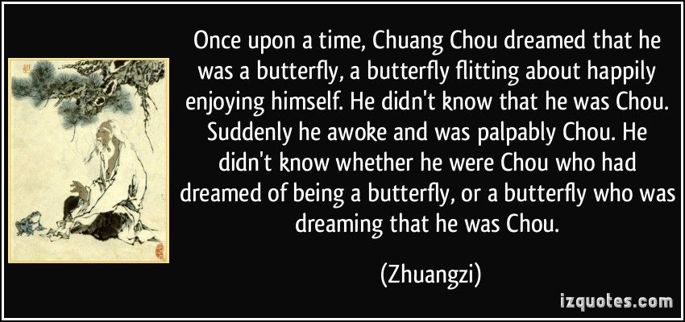
Inception

Slide 8
Inception
3
int inc(int a){
return a+1;
}
int sum(int a, int b){
int c = inc(a) + b;
return c;
}
int main(void){
int a = 2, b = 4, c;
c = sum(a, b);
printf("%d", c);
return 0;
}
3
Goodbye, cruel world!
inc()
a
2
7
7
sum()
a
b
c
7
2
4
2
4
main()
a
b
c

Slide 9
Same function called repeatedly
int inc(int a){
return a+1;
}
int sum(int a, int b){
int c = inc(a) + inc(b);
return c;
}
int main(void){
int a = 2, b = 4, c;
c = sum(a, b);
printf("%d", c);
return 0;
}
5
Hello again
3
5
3
inc()
Goodbye again
a
2
4
8
8
sum()
a
b
c
8
2
4
2
4
main()
a
b
c

Slide 10
The 6 Basic Rules of Functions
RULE 1: When we give a variable as input, the value stored inside that variable gets passed as an argument
RULE 2: When we give an expression as input, the value generated by that expression gets passed as argument
RULE 3: In case of a mismatch b/w type of arg promised and type of arg passed, typecasting will be attempted
WARNING: may cause loss of information or unexpected behavior

Slide 11


The 6 Basic Rules of Functions
Yes, you may have multiple return statements but the dream world clone will die the moment any one of them is seen
However, verify that the float returned is not negative
However, verify that the int gives an index within bounds
RULE 4: All values passed to a function get stored in a fresh variable inside that function
Modifying that value inside the function will NOT change the original value
Does not matter whether the value passed is char or long or an address
RULE 5: Value returned by a function can be used freely in any way values of that data-type could have been used
If function is returning a float, feel free to take square root with it
If function is returning an int, feel fee to use it as an array index
RULE 6: All clones share the memory address space
Let us look at this rule more closely
However, verify that the address returned isn’t NULL
Careful, all return statements must return only one value, and that too of the type promised in the function
Remember, Mr C terminates a function the moment any return statement is seen

Slide 12
RULE 6: the address rule
000000
000001
000002
000003
000004
000005
000006
000007
000008
000009
000010
000011
000012
000013
000014
000015
000016
000017
000018
000019
000020
000021
000022
000023
…
We have seen that the clones do not care what names other clones have given to variables – all passed values are copied
However, all clones see and work with the same shared memory
Consider an address 000008 – no matter which clone tries to read from, or write to, address 000008, they will all do so from the exact same address
Will exploit this feature very soon!
a
55
42
Memory location 000008 stores the integer 42
Memory location 000008 stores the integer 55
I also see 42 at memory location 00008
I also see 55 at memory location 00008
I too see 42 at location 000008
Guys, I am changing the value at location 000008 to 55
I too see 55 at location 000008

Slide 13
Passing simple variables/expressions
This is the case when the input to the function is either a variable (Rule 1) or an expression (Rule 2)
Rule 4 (fresh variables) will always apply no matter what is passed as input
Books, websites often call this technique pass-by-value
int neg(int a){
return -a;
}
int main(void){
int a = 2;
printf("%d", neg(a));
printf("%d", neg(4*2);
return 0;
}
-2
-8
-8
-2
neg()
a
-2-8
2
8
2
8
main()
a

Slide 14
Summary
We have seen how normal variables (int, float, char) can be passed to functions (rule 1) and how expressions of these (rule 2) can be passed to functions
Sometimes called pass-by-value
We have not yet seen how pointers (rule 1) and expressions that generate addresses (rule 2) can be passed to functions
Sometimes called pass-by-pointer or pass-by-reference
We will see this later
Remember - rule 4 always applies, no matter what!
Will see pass-by-array later

Slide 15
Next Class..
Static and global variables
Macros

